Slide 1
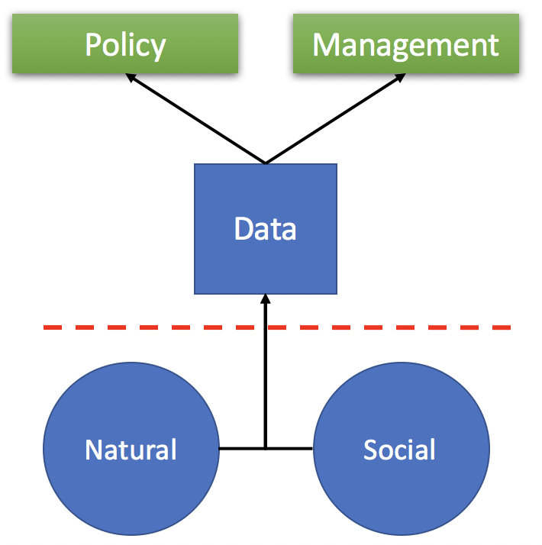
Ecological

Slide 2



